Slide 1
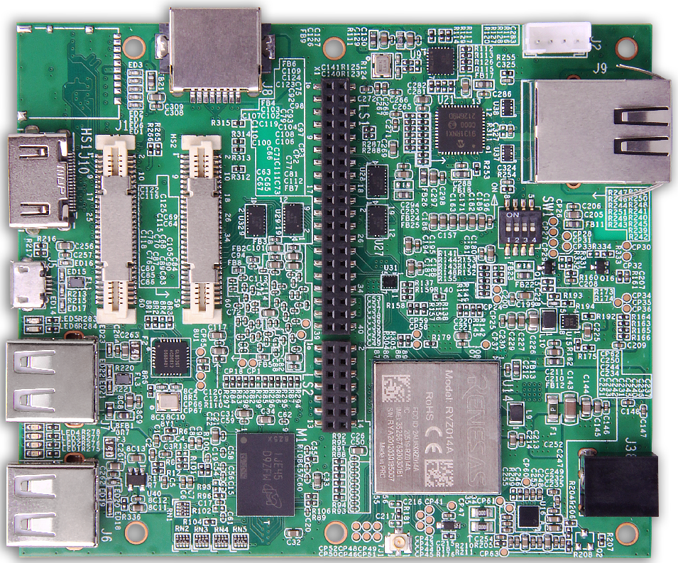
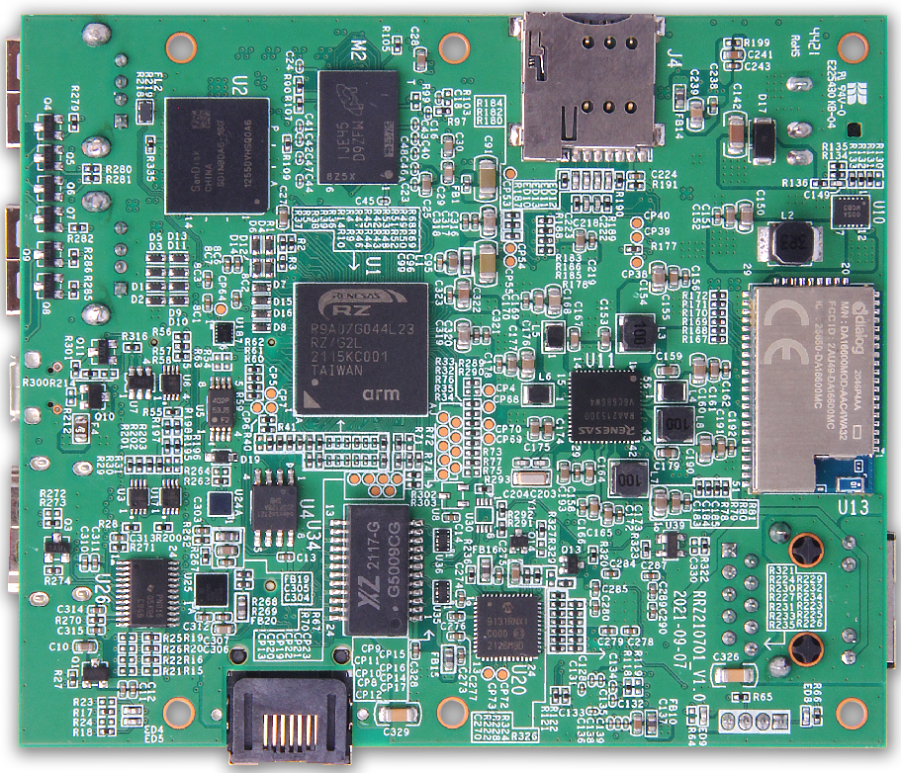
Key Features
The Geniatech AHAURA RS-G2L100 4G/LTE enabled Development Board follows the 96Boards.CE2.0 standard specification. Based on Renesas RZ/G2L and designed & manufactured by Geniatech in joint design collaboration with RENESAS.
a high-performance 64-bit Dual-core processor
HDMI out display support at resolutions up to 1080P
hardware video decodes at up to 1080P
up to 4GB of RAM
dual-band 2.4/5.0 GHz wireless LAN
Bluetooth 4.0
two Gigabit Ethernet
4G/LTE Modem.
Target Markets and Applications
Industrial Controls
Smart Home
Security
POS
Top view Bottom view

Slide 2

company blurb
Complete product portfolio & design manufacturing services from SOM plus Carrierboard to finish products, Vertical ODM/OEM services including ID/MD/Tooling/PCBA/Assembling and Artwork, scalable manafucturing from small to giant volume, fast time to market, rich experience on Linux, Android, software driver and cloud software, focus on SOM/SBC/ARM PC/HMI/Touch panel/Gateway and other ARM based devices for commercial and industrial applications, main SoC including NXP, Rockchip, Qualcomm, Renesas and Amlogic.

